Slide 1




Advanced Graph Algorithms
Spanning Trees, Shortest Paths, Strongly Connected Components, Bi-Connectivity, Max Flow
Advanced Graph Algorithms
SoftUni Team
Technical Trainers
Software University
http://softuni.bg

Slide 2

Table of Contents
Minimum Spanning Tree (MST)
Prim and Kruskal Algorithms
Lab: Implement Kruskal's Algorithm
Shortest Paths: Dijkstra's Algorithm
Lab: Implementing Dijkstra's Algorithm
Strongly-Connected Components
Bi-Connectivity and Articulation Points
Maximum Flow: Problem and Algorithm
Implementing Max-Flow with BFS Algorithm

Slide 3

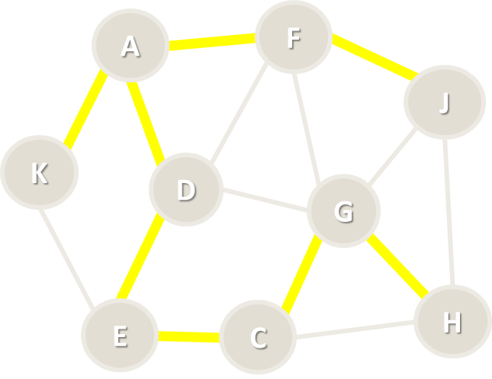
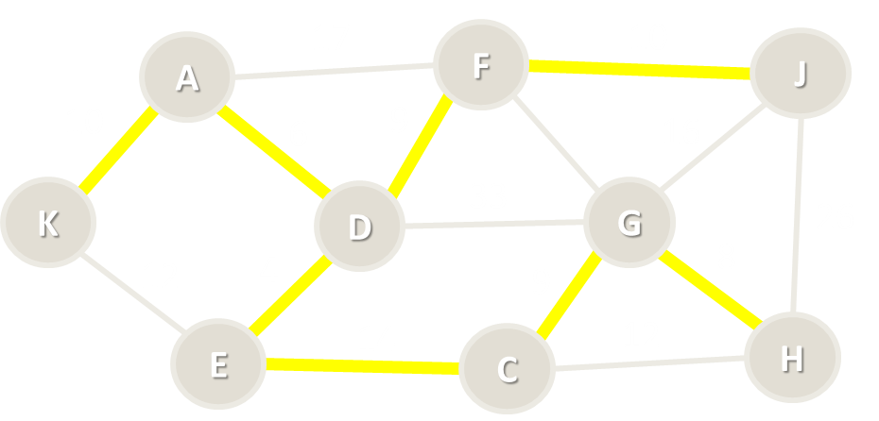
Minimum Spanning Tree (MST)

Slide 4
Spanning Tree
Spanning tree
Subgraph without cycles (tree)
Connects all vertices together
All connected graphs have a spanning tree
All undirected graphs have spanning forest
A
F
J
K
D
G
H
E
C

Slide 5

Minimum Spanning Tree (MST)
Minimum spanning tree (MST)
Weight <= weight(all other spanning trees)
First used in electrical networks
Minimal cost of wiring
17
F
14
A
J
10
6
13
11
16
K
D
33
G
26
12
4
9
20
E
14
22
H
C

Slide 6

Minimum Spanning Forest (MSF)
Minimum spanning forest
Set of all minimum spanning trees (when the graph is not connected)
L
8
7
B
10
I
17
F
14
A
J
10
6
13
11
16
K
D
33
G
26
12
4
9
20
E
14
C
22
H

Slide 7
Kruskal’s Algorithm
H
8
7
G
10
I
A
5
C
7
E
4
9
20
8
12
B
2
D
F

Slide 8
Kruskal’s Algorithm
Create a forest F holding all graph vertices and no edges
Create a set S holding all edges in the graph
While S if non-empty
Remove the edge e with min weight from S
If e connects two different trees
Add e to the forest
Join these two trees into a single tree
The graph may not be connected
H
8
7
G
10
I
A
5
C
7
E
4
9
20
8
12
B
2
D
F

Slide 9
Kruskal’s Algorithm – Step #1
Start from forest holding all vertices and no edges
S = all edges, ordered by weight
F = { }
S = {BD=2, AB=4, AC=5, CE=7, HI=7, DE=8, GH=8, AD=9, GI=10, EF=12, CD=20}
A
5
C
7
E
H
4
9
20
8
8
7
12
2
D
F
G
10
I
B

Slide 10
Kruskal’s Algorithm – Step #2
Take the smallest edge BD = 2
The edge BD connects different trees → add it to the forest
F = {BD=2}
S = {AB=4, AC=5, CE=7, HI=7, DE=8, GH=8, AD=9, GI=10, EF=12, CD=20}
A
5
C
7
E
H
4
9
20
8
8
7
12
2
D
F
G
10
I
B

Slide 11
Kruskal’s Algorithm – Step #3
Take the smallest edge AB = 4
The edge AB connects different trees → add it to the forest
F = {BD=2, AB=4}
S = {AC=5, CE=7, HI=7, DE=8, GH=8, AD=9, GI=10, EF=12, CD=20}
A
5
C
7
E
H
4
9
20
8
8
7
12
2
D
F
G
10
I
B

Slide 12
Kruskal’s Algorithm – Step #4
Take the smallest edge AC = 5
The edge AC connects different trees → add it to the forest
F = {BD=2, AB=4, AC=5}
S = {CE=7, HI=7, DE=8, GH=8, AD=9, GI=10, EF=12, CD=20}
A
5
C
7
E
H
4
9
20
8
8
7
12
2
D
F
G
10
I
B

Slide 13
Kruskal’s Algorithm – Step #5
Take the smallest edge CE = 7
The edge CE connects different trees → add it to the forest
F = {BD=2, AB=4, AC=5, CE=7}
S = {HI=7, DE=8, GH=8, AD=9, GI=10, EF=12, CD=20}
A
5
C
7
E
H
4
9
20
8
8
7
12
2
D
F
G
10
I
B

Slide 14
Kruskal’s Algorithm – Step #6
Take the smallest edge HI = 7
The edge CE connects different trees → add it to the forest
F = {BD=2, AB=4, AC=5, CE=7, HI=7}
S = {DE=8, GH=8, AD=9, GI=10, EF=12, CD=20}
A
5
C
7
E
H
4
9
20
8
8
7
12
2
D
F
G
10
I
B

Slide 15
Kruskal’s Algorithm – Step #7
Take the smallest edge DE = 8
The edge DE causes a cycle (connects the same tree) → skip it
F = {BD=2, AB=4, AC=5, CE=7, HI=7}
S = {GH=8, AD=9, GI=10, EF=12, CD=20}
A
5
C
7
E
H
4
9
20
8
8
7
12
2
D
F
G
10
I
B

Slide 16
Kruskal’s Algorithm – Step #8
Take the smallest edge GH = 8
The edge GH connects different trees → add it to the forest
F = {BD=2, AB=4, AC=5, CE=7, HI=7, GH=7}
S = {AD=9, GI=10, EF=12, CD=20}
A
5
C
7
E
H
4
9
20
8
8
7
12
2
D
F
G
10
I
B

Slide 17
Kruskal’s Algorithm – Step #9
Take the smallest edge AD = 9
The edge AD causes a cycle (connects the same tree) → skip it
F = {BD=2, AB=4, AC=5, CE=7, HI=7, GH=7}
S = {GI=10, EF=12, CD=20}
A
5
C
7
E
H
4
9
20
8
8
7
12
2
D
F
G
10
I
B

Slide 18
Kruskal’s Algorithm – Step #10
Take the smallest edge GI = 10
The edge GI causes a cycle (connects the same tree) → skip it
F = {BD=2, AB=4, AC=5, CE=7, HI=7, GH=7}
S = {EF=12, CD=20}
A
5
C
7
E
H
4
9
20
8
8
7
12
2
D
F
G
10
I
B

Slide 19
Kruskal’s Algorithm – Step #11
Take the smallest edge EF = 12
The edge EF connects different trees → add it to the forest
F = {BD=2, AB=4, AC=5, CE=7, HI=7, GH=7, EF=12}
S = {CD=20}
A
5
C
7
E
H
4
9
20
8
8
7
12
2
D
F
G
10
I
B

Slide 20
Kruskal’s Algorithm – Step #12
Take the smallest edge CD = 20
The edge CD causes a cycle (connects the same tree) → skip it
F = {BD=2, AB=4, AC=5, CE=7, HI=7, GH=7, EF=12}
S = { } → stop the algorithm
A
5
C
7
E
H
4
9
20
8
8
7
12
2
D
F
G
10
I
B

Slide 21
Kruskal’s Algorithm – Pseudo Code
foreach v ∈ graph edges
parent[v] = v
foreach edge {u, v} ordered by weight(u, v)
var rootU = FindRoot(u)
var rootV = FindRoot[v]
if rootU ≠ rootV
print edge {u, v}
parent[rootU] = rootV
FindRoot(node)
while (parent[node] ≠ node)
node = parent[node]
return node
Time complexity: O(M * log* M)
See http://visualgo.net/ufds.html

Slide 22
Disjoint Sets Optimization
FindRoot(node)
var root = node
while (parent[root] ≠ root)
root = parent[root]
// Optimize the path to root
// Attach each path node directly to the root
while (node != root)
var oldParent = parent[node]
parent[node] = root
node = oldParent
return root

Slide 23
Kruskal's Algorithm
A
5
C
7
E
H
4
9
20
8
8
7
12
2
D
F
G
10
I
B
Live Demo

Slide 24
Prim’s Algorithm
H
8
7
G
10
I
A
5
C
7
E
4
9
20
8
12
B
2
D
F

Slide 25
Prim’s Algorithm
Given a graph G(V, E) find the minimum spanning forest T(V', E')
Attach to the tree T the starting node
While smallest edge exists
Attach to T the smallest possible edge from G without creating a cycle in T
Use the smallest edge (u, v), such that u ∈ T and v ∉ T
Start the Prim's algorithm many times from all nodes from G still not in T
H
8
7
G
10
I
A
5
C
7
E
4
9
20
8
12
B
2
D
F

Slide 26
Prim’s Algorithm – Step #1
Start from the initial node A
Enqueue all edges from A to other graph nodes: AB, AC, AD
Spanning tree = {A}
Priority queue = {AB = 4}, {AC = 5}, {AD = 9}
A
5
C
7
E
H
4
9
20
8
8
7
12
2
D
F
G
10
I
B

Slide 27
Prim’s Algorithm – Step #2
Dequeue the shortest edge {AB = 4} and add it to the tree
Enqueue all edges from B to other graph nodes: BD
Spanning tree = {AB = 4}
Priority queue = {BD = 2}, {AC = 5}, {AD = 9}
A
5
C
7
E
H
4
9
20
8
8
7
12
2
D
F
G
10
I
B

Slide 28
Prim’s Algorithm – Step #3
Dequeue the shortest edge {BD = 2} and add it to the tree
Enqueue all edges from D to other graph nodes: DC, DE
Spanning tree = {AB = 4}, {BD = 2}
Priority queue = {AC = 5}, {DE = 8}, {AD = 9}, {CD = 20}
A
5
C
7
E
H
4
9
20
8
8
7
12
2
D
F
G
10
I
B

Slide 29
Prim’s Algorithm – Step #4
Dequeue the shortest edge {AC = 5} and add it to the tree
Enqueue all edges from C to other graph nodes: CE
Spanning tree = {AB = 4}, {BD = 2}, {AC = 5}
Priority queue = {CE = 7}, {DE = 8}, {AD = 9}, {CD = 20}
A
5
C
7
E
H
4
9
20
8
8
7
12
2
D
F
G
10
I
B

Slide 30
Prim’s Algorithm – Step #5
Dequeue the shortest edge {CE = 7} and add it to the tree
Enqueue all edges from E to other graph nodes: EF
Spanning tree = {AB = 4}, {BD = 2}, {AC = 5}, {CE = 7}
Priority queue = {DE = 8}, {AD = 9}, {EF = 12}, {CD = 20}
A
5
C
7
E
H
4
9
20
8
8
7
12
2
D
F
G
10
I
B

Slide 31
Prim’s Algorithm – Step #6
Dequeue the shortest edge {DE = 8}
It would create a loop in the spanning tree → skip it
Spanning tree = {AB = 4}, {BD = 2}, {AC = 5}, {CE = 7}
Priority queue = {AD = 9}, {EF = 12}, {CD = 20}
A
5
C
7
E
H
4
9
20
8
8
7
12
2
D
F
G
10
I
B

Slide 32
Prim’s Algorithm – Step #7
Dequeue the shortest edge {AD = 9}
It would create a loop in the spanning tree → skip it
Spanning tree = {AB = 4}, {BD = 2}, {AC = 5}, {CE = 7}
Priority queue = {EF = 12}, {CD = 20}
A
5
C
7
E
H
4
9
20
8
8
7
12
2
D
F
G
10
I
B

Slide 33
Prim’s Algorithm – Step #8
Dequeue the shortest edge {EF = 12} and add it to the tree
Enqueue all edges from F to other graph nodes: no such edges
Spanning tree = {AB = 4}, {BD = 2}, {AC = 5}, {CE = 7}, {EF = 12}
Priority queue = {CD = 20}
A
5
C
7
E
H
4
9
20
8
8
7
12
2
D
F
G
10
I
B

Slide 34
Prim’s Algorithm – Step #9
Dequeue the shortest edge {CD = 20}
It would create a loop in the spanning tree → skip it
Spanning tree = {AB = 4}, {BD = 2}, {AC = 5}, {CE = 7}, {EF = 12}
Priority queue = { } → stop the algorithm
A
5
C
7
E
H
4
9
20
8
8
7
12
2
D
F
G
10
I
B

Slide 35
Prim’s Algorithm – Step #10
Start from the initial node G
Enqueue all edges from G to other graph nodes: GH, GI
Spanning tree = {AB, BD, AC, CE, EF}, {G}
Priority queue = {GH = 8}, {GI = 10}
A
5
C
7
E
H
4
9
20
8
8
7
12
2
D
F
G
10
I
B

Slide 36
Prim’s Algorithm – Step #11
Dequeue the shortest edge {GH = 8} and add it to the tree
Enqueue all edges from H to other graph nodes: HI
Spanning tree = {AB, BD, AC, CE, EF}, {GH = 8}
Priority queue = {HI = 7}, {GI = 10}
A
5
C
7
E
H
4
9
20
8
8
7
12
2
D
F
G
10
I
B

Slide 37
Prim’s Algorithm – Step #12
Dequeue the shortest edge {HI = 7} and add it to the tree
Enqueue all edges from I to other graph nodes: no such edges
Spanning tree = {AB, BD, AC, CE, EF}, {GH = 8}, {HI = 7}
Priority queue = {GI = 10}
A
5
C
7
E
H
4
9
20
8
8
7
12
2
D
F
G
10
I
B

Slide 38
Prim’s Algorithm – Step #13
Dequeue the shortest edge {GI = 7} and add it to the tree
It would create a loop in the spanning tree → skip it
Spanning tree = {AB, BD, AC, CE, EF}, {GH = 8}, {HI = 7}
Priority queue = { } → stop the algorithm
A
5
C
7
E
H
4
9
20
8
8
7
12
2
D
F
G
10
I
B

Slide 39
Prim’s Algorithm (with Priority Queue)
var spanningTreeNodes = Ø
foreach (v ϵ graphVertices)
if (v ∉ spanningTreeNodes)
Prim(v)
Prim(startNode)
spanningTreeNodes ← startNode
var priorityQueue = Ø
priorityQueue ← childEdges(startNode)
while (priorityQueue is not empty)
smallestEdge = priorityQueue.ExtractMin()
if (smallestEdge connects tree node with non-tree node)
print smallestEdge
spanningTreeNodes ← smallestEdge.nonTreeNode
priorityQueue ← childEdges(smallestEdge.nonTreeNode)
Time complexity: O(M * log M)
1
8
7
4
10
7
0
5
8
7
6
4
9
20
8
12
2
3
2
5

Slide 40
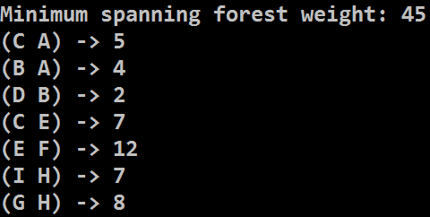
Prim's Algorithm with Priority Queue
H
8
7
G
10
I
A
5
C
7
E
4
9
20
8
12
B
2
D
F
Live Demo

Slide 41
Prim’s Algorithm – Pseudo Code
var usedNodes = Ø;
for (v = 0…n-1)
if (not usedNodes[v])
Prim(v);
Prim(startNode)
usedNodes ← startNode
var edgeNode[0 … n-1]
var nearest[0 … n-1]
// Initially compute nearest[0…n-1]
for (i = 0 … n-1)
nearest[i] = weight[startNode → i]
or infinity when no edge exists {startNode → i}
edgeNode[i] = startNode
Time complexity: O(N * N)
1
8
7
4
10
7
0
5
8
7
6
4
9
20
8
12
5
2
3
2

Slide 42
Prim’s Algorithm – Pseudo Code (2)
while (true)
nearestNode = node i such that
i ∉ usedNodes and nearest[i] is the minimum possible
if (nearestNode does not exists) → return
usedNodes ← nearestNode
print edge { edgeNode[nearestNode] → nearestNode }
// Update nearest[] and edgeNode[] through nearestNode for each i ∉ [0 … n-1] and i ∉ usedNodes
if edge exists { nearestNode → i }
if weight[nearestNode → i] < nearest[i]
nearest[i] = weight[nearestNode → i]
edgeNode[i] = nearestNode;
end while

Slide 43
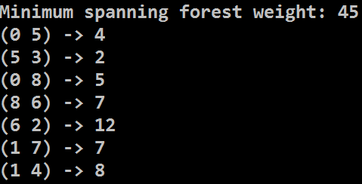
Prim's Algorithm with Adjacency Matrix
H
8
7
G
10
I
A
5
C
7
E
4
9
20
8
12
B
2
D
F
Live Demo

Slide 44
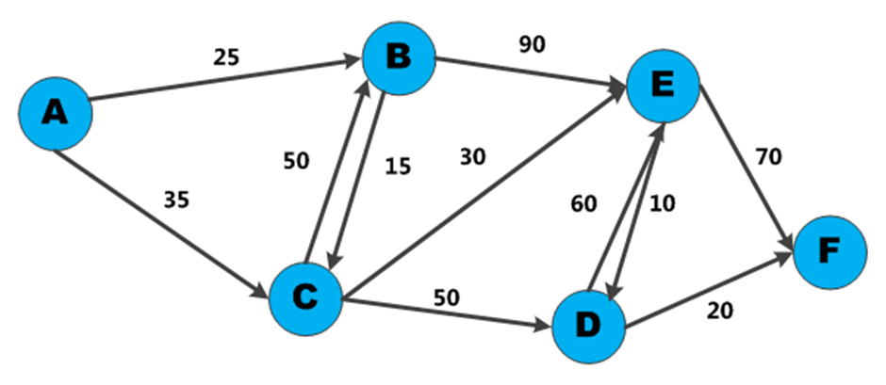

Dijkstra’s Algorithm
Shortest Paths in Graph

Slide 45
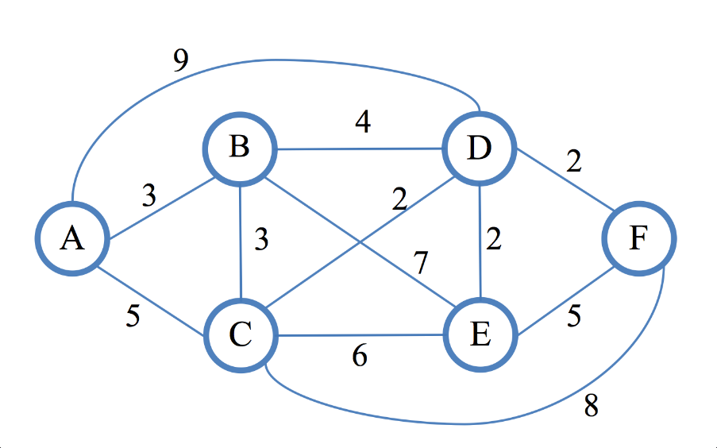
Dijkstra’s Algorithm
Dijkstra's algorithm finds the shortest path from given vertex to all other vertices in a directed / undirected weighted graph
First described by Edsger W. Dijkstra in 1956
Assumptions
Weights on edges are non-negative
Edges can be directed or not
Weights do not have to be distances
Shortest path is not necessarily unique
Not all edges need to be reachable

Slide 46
Shortest Path in Unweighted Graph
In unweighted graphs finding the shortest path can be done with BFS (all edges have the same weight):
1
2
K
3
F
H
Start
E
1
2
3
I
A
J
4
D
2
2
B
4
G
C

Slide 47
Weighted Shortest Paths with BFS
In weighted graphs
Break the edges into sub-vertices and use BFS
* Too much memory usage even for smaller graphs!
A
A
5
3
B
2
C
B
C

Slide 48
Dijkstra’s Algorithm
Dijskstra's algorithm is similar to BFS and to Prim's algorithms
Use a priority queue instead of queue
Keep the shortest distances so far
Steps in Dijkstra's algorithm:
v | A | B
d[v] | 30 | 15
v | A | B
d[v] | 25 | 15
Initially calculate all direct distances d[] from S
Enqueue that start node S
While (queue not empty)
Dequeue the nearest vertex B
Enqueue all unvisited child nodes of B
For each edge {B → A}, improve d[A] through B:
d[S → A] = min(d[S → A], d[S → B] + weight[B → A])
S
15
30
B
A
10

Slide 49
Dijkstra’s Algorithm: Step #1
Initialize all distances d[] from s: d[0…n-1] = ∞; d[s] = 0
Enqueue the start node (0)
v | 0 | 1 | 2 | 3 | 4 | 5 | 6 | 7 | 8 | 9 | 10 | 11
d[v] | 0 | - | - | - | - | - | - | - | - | - | - | -
prev[v] | - | - | - | - | - | - | - | - | - | - | - | -
17
4
20
6
1
3
10
6
5
11
6
5
s
0
5
33
11
9
7
26
12
3
9
20
3
10
8
14
2
15
7

Slide 50
Dijkstra’s Algorithm: Step #2
Dequeue the nearest vertex (0) and enqueue unvisited children: 6, 8
Improve min distances through child edges of 0: {0 → 6}, {0 → 8}
v | 0 | 1 | 2 | 3 | 4 | 5 | 6 | 7 | 8 | 9 | 10 | 11
d[v] | 0 | - | - | - | - | - | 10 | - | 12 | - | - | -
prev[v] | - | - | - | - | - | - | 0 | - | 0 | - | - | -
17
4
20
6
1
3
10
6
5
11
6
5
s
0
5
33
11
9
7
26
12
3
9
20
3
10
8
14
2
15
7

Slide 51
Dijkstra’s Algorithm: Step #3
Dequeue the nearest vertex (6) and enqueue unvisited children: 4, 5
Improve min distances through child edges of 6: {6 → 4}, {6 → 5}
v | 0 | 1 | 2 | 3 | 4 | 5 | 6 | 7 | 8 | 9 | 10 | 11
d[v] | 0 | - | - | - | 27 | 16 | 10 | - | 12 | - | - | -
prev[v] | - | - | - | - | 6 | 6 | 0 | - | 0 | - | - | -
17
4
20
6
1
3
10
6
5
11
6
5
s
0
5
33
11
9
7
26
12
3
9
20
3
10
8
14
2
15
7

Slide 52
Dijkstra’s Algorithm: Step #4
Dequeue the nearest vertex (8) and enqueue unvisited children: 2
Improve min distances through child edges of 8: {8 → 2}, {8 → 5}
v | 0 | 1 | 2 | 3 | 4 | 5 | 6 | 7 | 8 | 9 | 10 | 11
d[v] | 0 | - | 26 | - | 27 | 15 | 10 | - | 12 | - | - | -
prev[v] | - | - | 8 | - | 6 | 8 | 0 | - | 0 | - | - | -
17
4
20
6
1
3
10
6
5
11
6
5
s
0
5
33
11
9
7
26
12
3
9
20
3
10
8
14
2
15
7

Slide 53
Dijkstra’s Algorithm: Step #5
Dequeue the nearest vertex (5) and enqueue unvisited children: 11
Improve min distances through child edges of 5: {5 → 4}, {5 → 11}
v | 0 | 1 | 2 | 3 | 4 | 5 | 6 | 7 | 8 | 9 | 10 | 11
d[v] | 0 | - | 26 | - | 20 | 15 | 10 | - | 12 | - | - | 48
prev[v] | - | - | 8 | - | 5 | 8 | 0 | - | 0 | - | - | 5
17
4
20
6
1
3
10
6
5
11
6
5
s
0
5
33
11
9
7
26
12
3
9
20
3
10
8
14
2
15
7

Slide 54
Dijkstra’s Algorithm: Step #6
Dequeue the nearest vertex (4) and enqueue unvisited children: 1
Improve min distances through child edges of 4: {4 → 1}, {4 → 11}
v | 0 | 1 | 2 | 3 | 4 | 5 | 6 | 7 | 8 | 9 | 10 | 11
d[v] | 0 | 40 | 26 | - | 20 | 15 | 10 | - | 12 | - | - | 31
prev[v] | - | 4 | 8 | - | 5 | 8 | 0 | - | 0 | - | - | 4
17
4
20
6
1
3
10
6
5
11
6
5
s
0
5
33
11
9
7
26
12
3
9
20
3
10
8
14
2
15
7

Slide 55
Dijkstra’s Algorithm: Step #7
Dequeue the nearest vertex (2) and enqueue unvisited children: 7
Improve min distances through child edges of 2: {2 → 7}, {2 → 11}
v | 0 | 1 | 2 | 3 | 4 | 5 | 6 | 7 | 8 | 9 | 10 | 11
d[v] | 0 | 40 | 26 | - | 20 | 15 | 10 | 41 | 12 | - | - | 31
prev[v] | - | 4 | 8 | - | 5 | 8 | 0 | 2 | 0 | - | - | 4
17
4
20
6
1
3
10
6
5
11
6
5
s
0
5
33
11
9
7
26
12
3
9
20
3
10
8
14
2
15
7

Slide 56
Dijkstra’s Algorithm: Step #8
Dequeue the nearest vertex (11) and enqueue unvisited children: none
Improve min distances through child edges of 11: {11 → 1}, {11 → 7}
v | 0 | 1 | 2 | 3 | 4 | 5 | 6 | 7 | 8 | 9 | 10 | 11
d[v] | 0 | 37 | 26 | - | 20 | 15 | 10 | 41 | 12 | - | - | 31
prev[v] | - | 11 | 8 | - | 5 | 8 | 0 | 2 | 0 | - | - | 4
17
4
20
6
1
3
10
6
5
11
6
5
s
0
5
33
11
9
7
26
12
3
9
20
3
10
8
14
2
15
7

Slide 57
Dijkstra’s Algorithm: Step #9
Dequeue the nearest vertex (1) and enqueue unvisited children: 9
Improve min distances through child edges of 1: {1 → 7}, {1 → 9}
v | 0 | 1 | 2 | 3 | 4 | 5 | 6 | 7 | 8 | 9 | 10 | 11
d[v] | 0 | 37 | 26 | - | 20 | 15 | 10 | 41 | 12 | 42 | - | 31
prev[v] | - | 11 | 8 | - | 5 | 8 | 0 | 2 | 0 | 1 | - | 4
17
4
20
6
1
3
10
6
5
11
6
5
s
0
5
33
11
9
7
26
12
3
9
20
3
10
8
14
2
15
7

Slide 58
Dijkstra’s Algorithm: Step #10
Dequeue the nearest vertex (7) and enqueue unvisited children: none
Improve min distances through child edges of 7: {7 → 9}
v | 0 | 1 | 2 | 3 | 4 | 5 | 6 | 7 | 8 | 9 | 10 | 11
d[v] | 0 | 37 | 26 | - | 20 | 15 | 10 | 41 | 12 | 42 | - | 31
prev[v] | - | 11 | 8 | - | 5 | 8 | 0 | 2 | 0 | 1 | - | 4
17
4
20
6
1
3
10
6
5
11
6
5
s
0
5
33
11
9
7
26
12
3
9
20
3
10
8
14
2
15
7

Slide 59
Dijkstra’s Algorithm: Step #11
Dequeue the nearest vertex (9) and enqueue unvisited children: none
Improve min distances through child edges of 9: none
v | 0 | 1 | 2 | 3 | 4 | 5 | 6 | 7 | 8 | 9 | 10 | 11
d[v] | 0 | 37 | 26 | - | 20 | 15 | 10 | 41 | 12 | 42 | - | 31
prev[v] | - | 11 | 8 | - | 5 | 8 | 0 | 2 | 0 | 1 | - | 4
17
4
20
6
1
3
10
6
5
11
6
5
s
0
5
33
11
9
7
26
12
3
9
20
3
10
8
14
2
15
7

Slide 60
Dijkstra’s Algorithm: Step #12
The queue is empty → Dijkstra's algorithm is completed
d[v] hold shortest distances; prev[v] holds shortest paths tree edges
v | 0 | 1 | 2 | 3 | 4 | 5 | 6 | 7 | 8 | 9 | 10 | 11
d[v] | 0 | 37 | 26 | - | 20 | 15 | 10 | 41 | 12 | 42 | - | 31
prev[v] | - | 11 | 8 | - | 5 | 8 | 0 | 2 | 0 | 1 | - | 4
17
4
20
6
1
3
10
6
5
11
6
5
s
0
5
33
11
9
7
26
12
3
9
20
3
10
8
14
2
15
7

Slide 61
Dijkstra’s Algorithm: Step #13
The output is the shortest paths tree from the starting node to all others
Reconstruct the path destination to source using prev[v]
v | 0 | 1 | 2 | 3 | 4 | 5 | 6 | 7 | 8 | 9 | 10 | 11
d[v] | 0 | 37 | 26 | - | 20 | 15 | 10 | 41 | 12 | 42 | - | 31
prev[v] | - | 11 | 8 | - | 5 | 8 | 0 | 2 | 0 | 1 | - | 4
prev[v] holds the shortest paths tree edges
Path[9 → 0] = {9 → 1 → 11 → 4 → 5 → 6 → 0}
4
6
1
10
5
11
6
5
0
5
11
9
12
3
8
14
15
7
2

Slide 62
Dijkstra’s Algorithm – Pseudo Code
d[0…n-1] = INFINITY; d[startNode] = 0
Q = priority queue holding nodes ordered by distance d[]
startNode → Q
while (Q is not empty)
minNode = dequeue the smallest node from Q
if (d[minNode] == INFINITY) break;
foreach (child c of minNode)
if (c is unvisited) c → Q
newDistance = d[minNode] + distance {minNode → c}
if (newDistance < d[c])
d[c] = newDistance;
reorder Q;
}

Slide 63
Dijkstra’s Algorithm – More Details
Modifications
Implementation with array, queue, priority queue
Having a target node + stop when it is found
Saving the shortest paths tree (prev[v])
Complexity depends on the implementation
Typical implementation (with array): O(n * n)
With priority queue: O(n + m) * log(n)
Applications – maps, GPS, networks, air travel, etc.

Slide 64
Dijkstra’s Algorithm
17
4
20
6
1
3
10
6
5
11
6
5
s
0
5
33
11
9
7
26
12
3
9
20
3
10
8
14
2
15
7
Live Demo

Slide 65
Strongly-Connected Components
5
9
1
10
6
12
13
0
3
4
7
2
11
8
The DFS-Based Algorithm

Slide 66
Strongly-Connected Components
A directed graph is strongly-connected
When every two vertices are connected by path
Example of strongly-connected graph:
9
1
10
6
7
0
3
4
2
5
8

Slide 67
Strongly-Connected Components
Strongly-connected component is a maximal strongly-connected subgraph (component with paths between any two nodes)
A directed graph can be decomposed into strongly-connected components, e.g.
5
9
1
10
6
12
13
0
3
4
7
2
11
8

Slide 68
Kosaraju–Sharir Algorithm
Let G be a directed graph and S be an empty stack
For each vertex v in G
Call DFS(v) to traverse the graph (visit each node once)
Each time DFS(v) finishes (before recursive return), push v onto S
Build the reverse graph G' (reverse all edges from G)
While S is non-empty:
Pop the top vertex v from S
if v is not visited, call ReverseDFS(v) to find the next strongly-connected component

Slide 69
Kosaraju–Sharir Algorithm
5
9
1
10
6
12
13
0
3
4
7
2
11
8
Live Demo

Slide 70
Bi-Connectivity
9
1
10
6
3
5
7
0
4
2
11
8
Finding the Articulation Points

Slide 71
Articulation Points
In a connected undirected graph an articulation point is a node that when removed, splits the graph into several components
The blue nodes below are the articulation points: 7, 0, 6, 4
There are 6 bi-connected components:
{5, 7}, {0, 2, 7, 9}, {1, 0, 6}, {6, 8, 11}, {4, 6, 10}, {3, 4}
9
1
10
6
3
5
7
0
4
2
11
8

Slide 72
Articulation Points – The Slow Algorithm
The straightforward algorithm – O(n * (m + n))
Remove each node and check whether the graph stays connected
Check for graph connectivity by DFS traversal + counting the number of visited nodes
foreach v ∈ graph nodes
temporary remove v
check for connectivity with DFS(u), where u ≠ v
if the graph is not connected, print v
restore v back in the graph

Slide 73
Articulation Points – The Fast Algorithm
The fast (linear) algorithm for finding articulation points is based on DFS traversal with some computations (Hopcroft, Tarjan, 1973)
Run a DFS while maintaining the following information:
The depth(v) of each vertex in the DFS tree (once it gets visited)
For each vertex v, the lowest depth of neighbors of all descendants of v in the DFS tree, called the lowpoint(v)
A non-root vertex v is an articulation point if there is a child y of v such that lowpoint(y) ≥ depth(v)
The root vertex is an articulation point if it has at least two children

Slide 74
Articulation Points – Fast Algorithm
FindArticulationPoints(node, d)
visited[node] = true
depth[node] = d
lowpoint[node] = d
childCount = 0
isArticulation = false
for each childNode in childNodes[node]
if not visited[childNode]
parent[childNode] = node
FindArticulationPoints(childNode, d + 1)
childCount = childCount + 1
if lowpoint[childNode] >= depth[node]
isArticulation = true
lowpoint[node] = Min(lowpoint[node], lowpoint[childNode])
else if childNode <> parent[node]
lowpoint[node] = Min(lowpoint[node], depth[childNode])
if (parent[node]<>null and isArticulation) or (parent[node]==null and childCount > 1)
print node as articulation point
Time complexity: O(N + M)

Slide 75
Finding the Articulation Points
9
1
10
6
3
5
7
0
4
2
11
8
Live Demo

Slide 76
Max Flow
17
4
20
6
1
3
30
6
5
11
6
25
t
s
33
9
0
5
11
26
7
22
3
9
20
23
10
8
14
2
15
7
Finding the Maximum Network Flow

Slide 77
Max Flow Problem
Weighted directed / undirected graph
With capacities assigned to the edges c(u → v)
Goal: compute the maximum flow from node s to node t
Each edge {u → v} holds certain flow flow(u → v)
flow(u → v) ≤ c(u → v)
For each node input flow == output flow
Max flow == sum(flow(s → v)) == sum(flow(u → t))
Total output flow from s == total input from to t

Slide 78
Ford-Fulkerson Max-Flow Algorithm
Start from zero flow: flow(u → v) = 0 for each edge
While possible:
Find augmenting path p such that
p is a valid path in the graph from s to t
For each edge {u → v} ∈ p → flow(u → v) < c(u → v)
For each edge {u → v} ∈ p → flow(u → v) < c(u → v)
Augment the flow through this path to the maximum possible

Slide 79
Max Flow – Step #1
Start from empty flows through all edges
Find an augmenting path: 0 → 6 → 4 → 1 → 7 → 9 (increment = 17)
0/17
4
0/20
6
1
0/30
0/6
0/5
0/11
0/6
0/25
t
s
0/33
9
0
5
11
0/26
0/22
0/3
0/20
0/9
0/15
0/23
8
0/14
2
7

Slide 80
Max Flow – Step #2
Augment the flow through the path: 0 → 6 → 4 → 1 → 7 → 9 (increment = 17)
Current max flow = 17
17/17
4
17/20
6
1
17/30
0/6
0/5
0/11
0/6
0/25
t
s
0/33
9
0
5
11
17/26
0/22
0/3
0/20
0/9
0/15
17/23
8
0/14
2
7

Slide 81
Max Flow – Step #3
Find an augmenting path: 0 → 6 → 5 → 4 → 1 → 7 → 9 (increment = 3)
17/17
4
17/20
6
1
17/30
0/6
0/5
0/11
0/6
0/25
t
s
0/33
9
0
5
11
17/26
0/22
0/3
0/20
0/9
0/15
17/23
8
0/14
2
7

Slide 82
Max Flow – Step #4
Augment the flow through the path: 0 → 6 → 5 → 4 → 1 → 7 → 9 (increment = 3)
Current max flow = 20
17/17
4
20/20
6
1
20/30
3/6
3/5
0/11
0/6
0/25
t
s
0/33
9
0
5
11
20/26
0/22
0/3
0/20
0/9
0/15
20/23
8
0/14
2
7

Slide 83
Ford-Fulkerson Algorithm
17/17
4
20/20
6
1
20/30
3/6
3/5
0/11
0/6
0/25
t
s
0/33
9
0
5
11
20/26
0/22
0/3
0/20
0/9
0/15
20/23
8
0/14
2
7
Live Demo

Slide 84

Summary
Minimum spanning tree (MST)
Solved by Prim's and Kruskal's algorithms
Shortest paths in a graph:
Use the classical Dijkstra's algorithm / Floyd
Strongly-connected components
Use DFS + reverse DFS algortihm
Articulation points → use modified DFS
Maximum flow: use Ford-Fulkerson / other algorithm

Slide 85









Advanced Graph Algorithms
https://softuni.bg/trainings/1194/Algorithms-September-2015

Slide 86
License
This course (slides, examples, labs, videos, homework, etc.) is licensed under the "Creative Commons Attribution-NonCommercial-ShareAlike 4.0 International" license
Attribution: this work may contain portions from
"Fundamentals of Computer Programming with C#" book by Svetlin Nakov & Co. under CC-BY-SA license
"Data Structures and Algorithms" course by Telerik Academy under CC-BY-NC-SA license

Slide 87





Free Trainings @ Software University
Software University Foundation – softuni.org
Software University – High-Quality Education, Profession and Job for Software Developers
softuni.bg
Software University @ Facebook
facebook.com/SoftwareUniversity
Software University @ YouTube
youtube.com/SoftwareUniversity
Software University Forums – forum.softuni.bg

